Slide 1
Network Analysis and Visualization
Chun Su

Slide 2
Agenda
Network analysis basics
R object IGRAPH ”I/O”
object IGRAPH manipulation
Graph advance
Graph measurement
Graph cluster
Network visualization
Aesthetics of network elements
Network layout
Network application show case
Group Exercise – NYC flight

Slide 3
What is network analysis?
Network analysis is to study the inter-relationships between actors of all sorts and provides an architectural view of individual connections. In mathematics, it is part of graph theory.
Network analysis are widely used in
Computer science . eg. computational devices connection
Linguistics . eg. natural language flow
Social sciences. eg. social network
Biology. eg. gene regulation network
https://www.lyonwj.com/2016/06/26/graph-of-thrones-neo4j-social-network-analysis/
https://en.wikipedia.org/wiki/Graph_theory

Slide 4
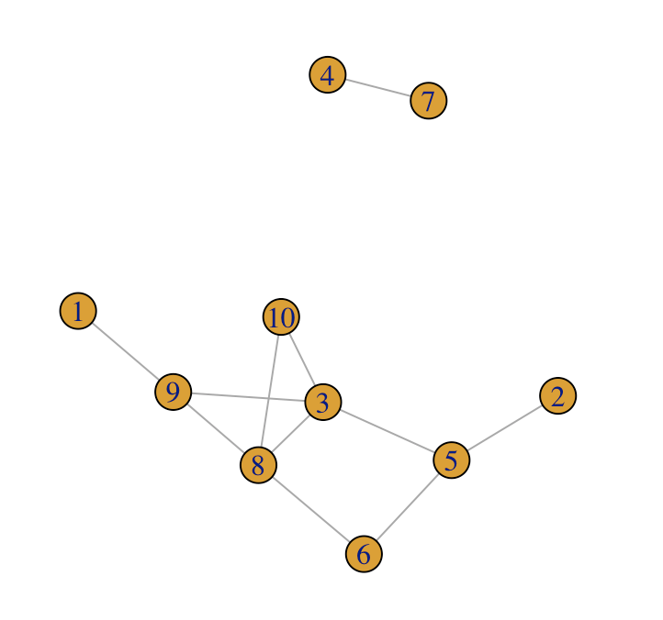
Graph elements (Glossaries I)
Vertex: is the node of network
Edge: the connection of notes, sometimes called "link".
Directed
undirected
Graph: constitute of vertices and edges, which represents the whole inter-relationship of nodes.
Notes:
depending on whether the distinction between source and target is meaningful.
order 0 is always v itself, order 1 is v plus its immediate neighbors, order 2 is order 1 plus the immediate neighbors of the vertices in order 1, etc.

Slide 5
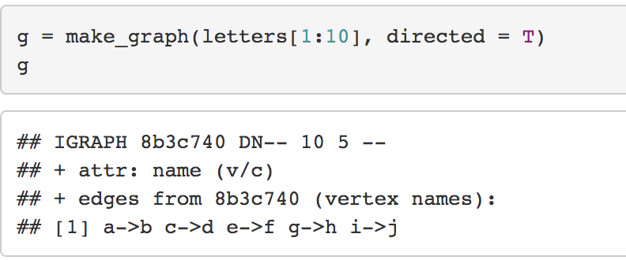
IGRAPH object in R
Package igraph have a class ‘igraph’.
Named
Edge #
Directed
vertex #
Attribute can be associated with either vertex (v) or edge (e) or both.
Special attributes, name, can be used to select vertices and edges (“from|to”).
Notes:
Some vertex/edge/graph attributes are treated specially. Like name.
The form ‘from|to’, where ‘from’ and ‘to’ are vertex names

Slide 6
Create IGRAPH
IGRAPH can be created in multiple ways
Easy graph:
graph_from_literal
make_graph
Create from user data:
graph_from_edgelist
graph_from_adjacency_matrix
graph_from_data_frame
Classic random graphs:
sample_gnp
sample_gnm
sample_pa
sample_smallworld

Slide 7
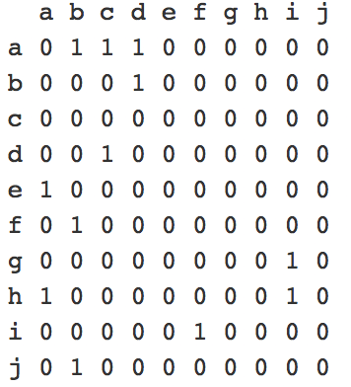
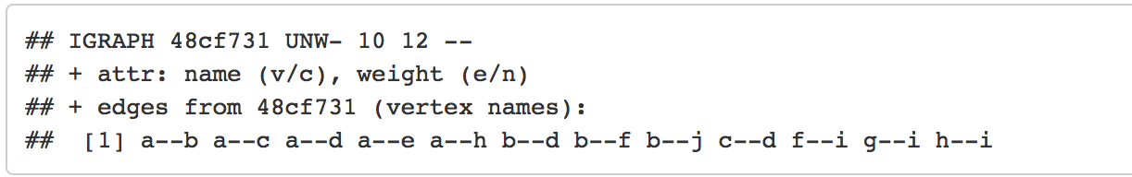
graph_from_adjacency_matrix
g = graph_from_adjacency_matrix(adj_matrix, mode = "undirected", weighted = T)
g

Slide 8
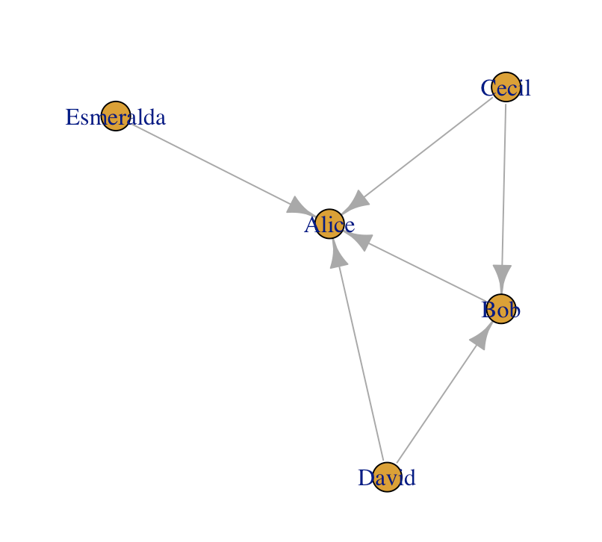
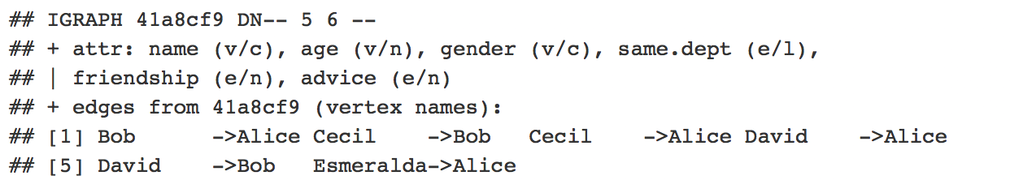
graph_from_data_frame
actors <- data.frame(
name=c("Alice", "Bob", "Cecil", "David","Esmeralda"),
age=c(48,33,45,34,21),
gender=c("F","M","F","M","F")
)
relations <- data.frame(
from=c("Bob", "Cecil", "Cecil", "David","David", "Esmeralda"),
to=c("Alice", "Bob", "Alice", "Alice", "Bob", "Alice"),
same.dept=c(FALSE,FALSE,TRUE,FALSE,FALSE,TRUE),
friendship=c(4,5,5,2,1,1),
advice=c(4,5,5,4,2,3)
)
g <- graph_from_data_frame(relations, directed=TRUE, vertices=actors)
g

Slide 9
Retrieve vertex and Edges from IGRAPH
Vertex and Edges are saved as ”igraph.vs” and ”igraph.es” object respectively. Can be retrieved using V(g) and E(g).
V(g)$name
V(g)$age
V(g)$gender
# [1] "Alice" "Bob" "Cecil" "David" "Esmeralda"
# [1] 48 33 4 5 34 21
# [1] "F" "M" "F" "M" "F"
E(g)$same.dept
E(g)$friendship
# [1] FALSE FALSE TRUE FALSE FALSE TRUE
# [1] 4 5 5 2 1 1

Slide 10
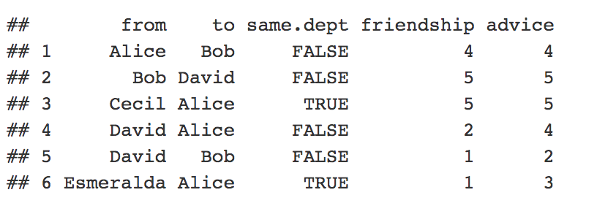
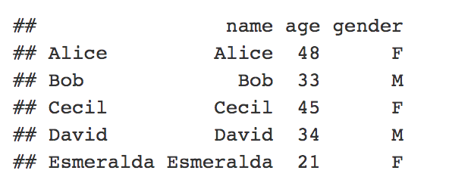
Retrieve vertex and Edges from IGRAPH
as_data_frame(g, what = "vertices")
as_data_frame(g, what = "edges")

Slide 11
Add vertex and edges to IGRAPH
# add vertices
g %>% add_vertices(2, name=c("Lisa","Zack")) # the first argument is number of vertex
g + vertices(c("Lisa","Zack"))
# add connected edges (even number of vertices). The vertices must be from known vertices already in the graph
g %>% add_edges(c("Alice","Bob"))
g + edge(c("Alice","Bob"))
# add paths. The vertices must be from known vertices already in the graph
g + path("Alice","Bob","Cecil")
# If a new vertex needs to be added to current graph, using add graph method instead
g + make_graph(c("Alice","Bob","Bob","Melisa"))

Slide 12
Delete vertex and edges from IGRAPH
### remove the vertices whose age is younger than 30
vertex_df = g %>% as_data_frame(what="vertices") %>% tbl_df %>% mutate(index=row_number()) %>% filter(age < 30)
# remove vertices by index number
g %>% delete_vertices(vertex_df$index)
# remove vertice by name
g %>% delete_vertices(vertex_df$name)
### remove the edges with friendship <= 1
edge_df = g %>% as_data_frame(what="edges") %>% tbl_df %>% mutate(index=row_number()) %>% mutate(name=paste(from,to,sep="|")) %>% filter(friendship <= 1)
# remove vertice by index
g %>% delete_edges(edge_df$index)
# remove vertice by name
g %>% delete_edges(edge_df$name)

Slide 13
Add and delete vertex and edge attributes to IGRAPH
Add/change new edge attributes using set_edge_attr().
Add/change new vertice attributes using set_vertex_attr()
Delete edge attributes using delete_edge_attr(g,attr_name).
Delete vertice attributes using delete_vertice_attr(g,attr_name,index,attr_value)
# add a new attr "relationship" for people in the same dept
edge_df = g %>%
as_data_frame(what="edges") %>%
mutate(
relationship=ifelse(same.dept,"collegue",NA)
)
g %>%
set_edge_attr(
"relationship", which(!is.na(edge_df$relationship)), edge_df$relationship[!is.na(edge_df$relationship)]
)

Slide 14
Merge Graph
g
g2
#### create new graph g2
g2 = graph_from_literal(
"David"-+"Charlie"+-+"Lisa",
"Lisa"+-+"David"+-"Jim",
"Zack"+-"Esmeralda"-+"Bob",
"Zack"+-"Charlie",
"Lisa"+-"Lisa",
"Bob"-+"Alice"+-"Esmeralda"
)
#### union graph
g3 = igraph::union(g,g2)
#### graph intersection
g4 = igraph::intersection(g,g2)
g:g2 union
g:g2 intersect

Slide 15
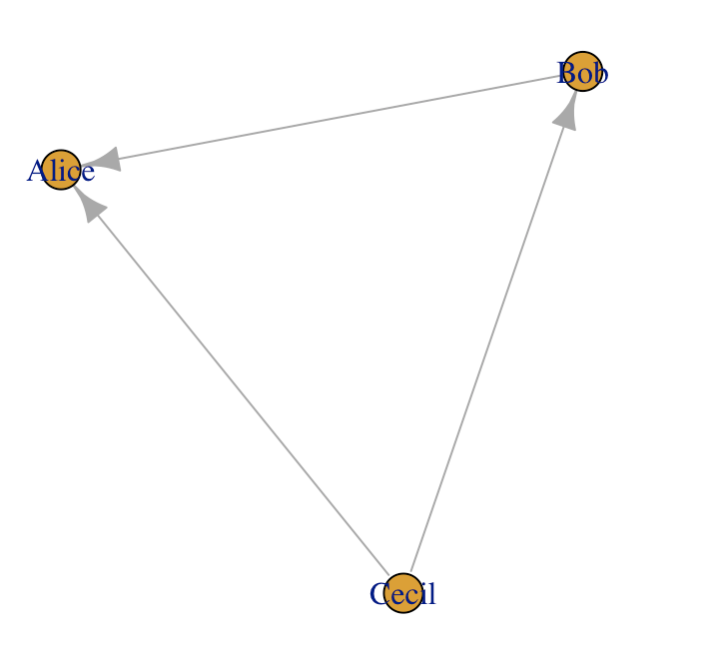
Subgraph
Subgraph can be induced by vertice and edge names or igraph.es
# induce a subgraph using a list of vertice names
induced_subgraph(g, v=c("Alice","Bob","Cecil"))
# induce a subgraph using edges
subgraph.edges(g, c("Bob|Alice","Cecil|Bob","Cecil|Alice"), delete.vertices = TRUE)
# induce a subgraph using edges attribute (friendship score stronger than 3)
e1 = E(g)[E(g)$friendship > 3]
subgraph.edges(g, e1, delete.vertices = TRUE)

Slide 16
Agenda
Network analysis basics
R object IGRAPH ”I/O”
object IGRAPH manipulation
Graph advance
Graph measurement
Graph cluster
Network visualization
Aesthetics of network elements
Network layout
Network application show case
Group Exercise– NYC flight

Slide 17
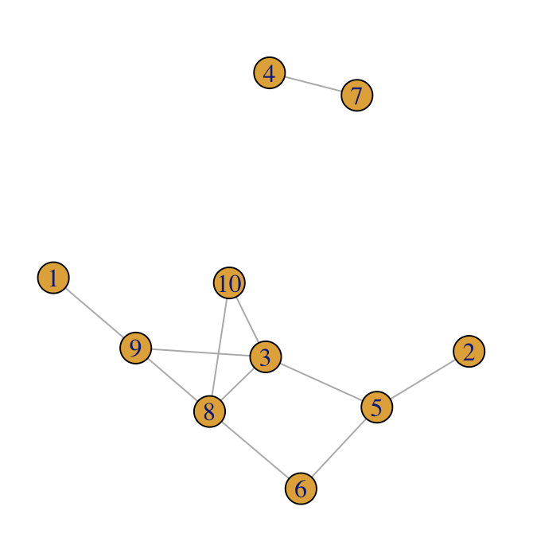
Graph measurement – degree and strength
Degree: the number of adjacent vertex.
# get degree for each node
degree(gr, v=1:10))
# [1] 1 1 4 1 3 2 1 4 3 2
# generate random graph
set.seed(12)
gr <- sample_gnp(10, 0.3)
plot(gr)
# probability for degree
degree_distribution(g)
# [1] 0.0 0.4 0.2 0.2 0.2
Strength: is weighted version of degree, by summing up the edge weights of the adjacent edges for each vertex
# add random weight attribute
set.seed(12)
gr = gr %>% set_edge_attr(
"weight",index=E(gr),
value=sample(seq(0,1,0.05),size=length(E(gr)))
)
# calculate strength
strength(gr, weights = E(gr)$weight)
# [1] 0.95 0.05 1.90 0.20 1.70 0.85 0.20 1.75 2.10 1.50

Slide 18
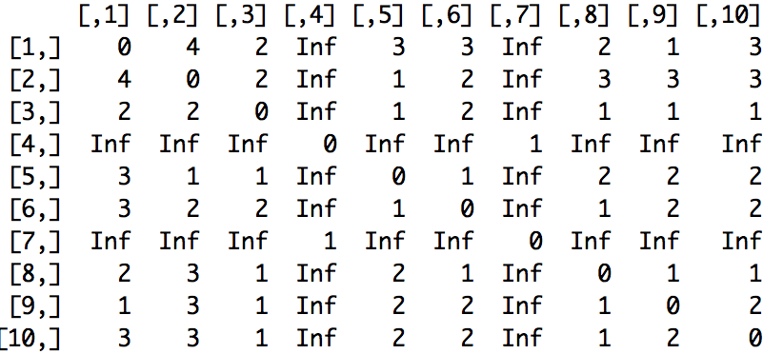
Graph measurement – distance and path
Order/Distances : how far away from one vertex to another.
# count all edges from David to Cecil, regardless of direction
distances(gr, v=1, to=10, mode="all”, weights = NA)
# [,1]
# [1,] 3
# pairwise distance table
distances(gr, mode=“all”)
Path: a route between any two vertices
# shortest path to connect
all_shortest_paths(gr, 1,10)$res
# $res[[1]]
# + 4/10 vertices, from 82b58b9:
# [1] 1 9 8 10
# $res[[2]]
# + 4/10 vertices, from 82b58b9:
# [1] 1 9 3 10
# all path to connect
all_simple_paths(gr, 1,10)
Both return a list of igraph.vs

Slide 19
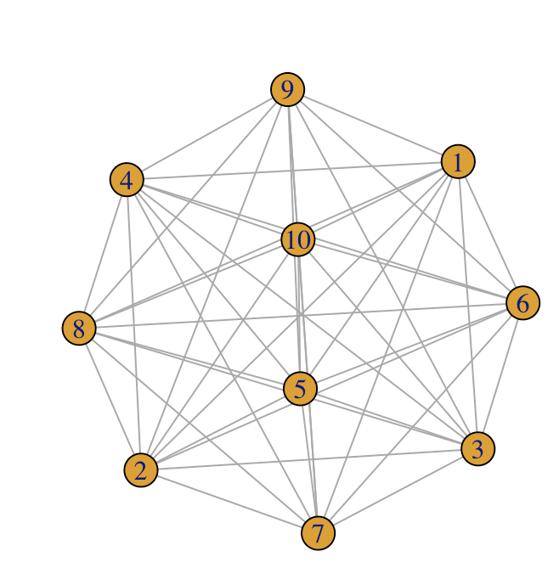
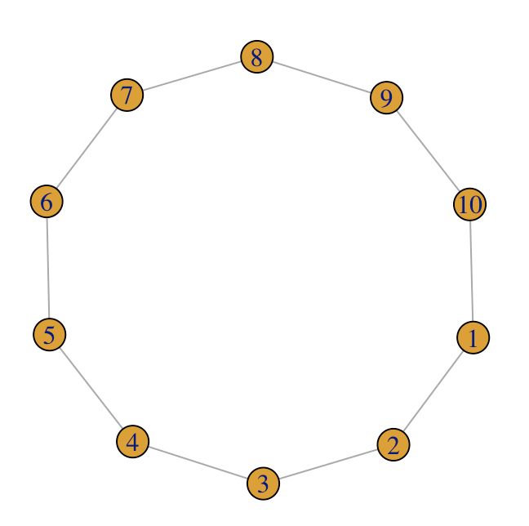
Graph measurement – transitivity
Transitivity measures the probability that the adjacent vertices of a vertex are connected. also called the clustering coefficient
# two extreme classes -- full graph and ring graph
g1 = make_full_graph(10)
transitivity(g1)
## [1] 1
g2 = make_ring(10)
transitivity(g2)
## [1] 0
A property very important in social networks, and to a lesser degree in other networks
g1
g2

Slide 20
Graph measurement -- centrality
Centrality: measures the importance of a node in a network.
However, this “importance” can be conceived in two ways:
in relation to a type of flow or transfer across the network.
involvement in the cohesiveness of the network
degree centrality (centr_degree)
closeness centrality (centr_clo)
betweenness centrality (centr_betw)
eigenvector centrality (centr_eigen)
…..
centr_betw(gr, directed = FALSE)
## $res
## [1] 0.0 0.0 8.0 0.0 6.5 1.0 0.0 4.5 6.0 0.0
## $centralization
## [1] 0.1666667
## $theoretical_max
## [1] 324
Notes:
* closeness centrality (centr_clo) - a node is important if it takes the shortest mean distance from a vertex to other vertices * betweenness centrality (centr_betw) - a node is important if extent to which a vertex lies on paths between other vertices are high. * eigenvector centrality (centr_eigen) - a node is important if it is linked to by other important nodes.
Centralization is a general method for calculating a graph-level centrality score based on node-level centrality measure. The formula for this is
C(G)=∑v(maxwcw−cv),

Slide 21
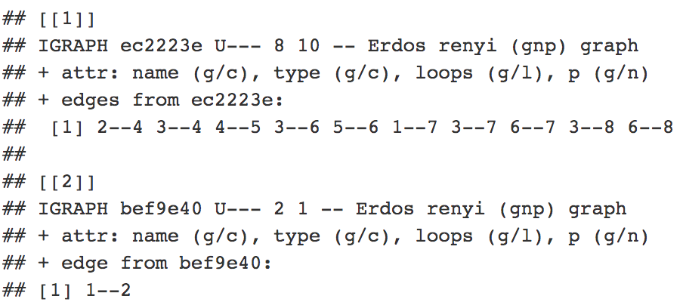
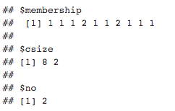
Decompose graph to components
A component is a subgraph in which all nodes are inter-connected.
# decompose graph to connected components
dg <- decompose.graph(gr)
dg
#summarize components of graph
components(gr)

Slide 22
Graph cluster -- cliques
Clique: fully connected subgraph in which the every vertex connects with every other vertex.
# extract cliques that contain more than 3 vertices
cliques(g, min=3)
# get cliques with largest number of vertices
largest_cliques(g)

Slide 23
Graph cluster – community/module
Communities: defined if the nodes of the network can be easily grouped into (potentially overlapping) sets of nodes such that each set of nodes is densely connected internally
Modularity: measure the strength of division of a network into community, used in optimization methods for detecting community structure in networks
https://en.wikipedia.org/wiki/Modularity_(networks)#Modularity

Slide 24
Cluster graph – community/module (cont.)
There are many ways to cluster graph to communities. The functions in igraph packages include
cluster_edge_betweenness - a hierarchical decomposition process where edges are removed in the decreasing order of their edge betweenness scores
cluster_optimal - a top-down hierarchical approach that optimizes the modularity function
cluster_walktrap - an approach based on random walks
cluster_fast_greedy
cluster_label_prop
cluster_leading_eigen
cluster_Louvain
cluster_spinglass
https://stackoverflow.com/questions/9471906/what-are-the-differences-between-community-detection-algorithms-in-igraph
https://en.wikipedia.org/wiki/Community_structure
Notes:
short random walks tend to stay in the same community.

Slide 25
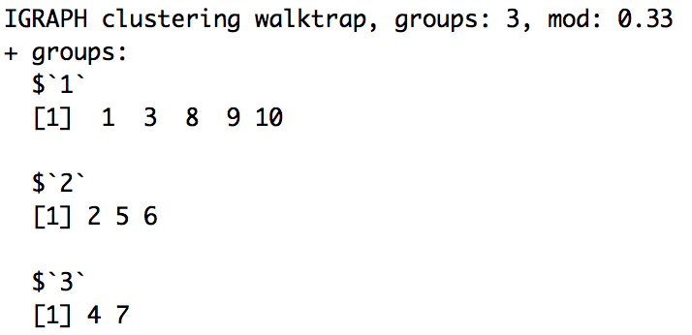
Cluster graph – community/module (cont.)
# cluster graph using walktrap method, turn a ”communities” object
wtc <- cluster_walktrap(gr)
wtc
# find membership for each vertice
membership(wtc)
## [1] 1 2 1 3 2 2 3 1 1 1
# calculate modularity for walktrap clustering on this graph
modularity(wtc)
## [1] 0.3305785

Slide 26
Agenda
Network analysis basics
R object IGRAPH ”I/O”
object IGRAPH manipulation
Graph advance
Graph measurement
Graph cluster
Network visualization
Aesthetics of network elements
Network layout
Network application show case
Group Exercise– NYC flight

Slide 27
Aesthetics of network elements
The aesthetics of both vertices and edges can be manipulated at color, transparency.
Specially for vertices, we can also manipulate its shape, size and fill.
For edges, we can manipulate its width/thickness, linetype, arrow and so on.
actors <- data.frame(
name=c("Alice", "Bob", "Cecil", "David","Esmeralda"),
age=c(48,33,45,34,21),
gender=c("F","M","F","M","F")
)
relations <- data.frame(
from=c("Bob", "Cecil", "Cecil", "David","David", "Esmeralda"),
to=c("Alice", "Bob", "Alice", "Alice", "Bob", "Alice"),
same.dept=c(FALSE,FALSE,TRUE,FALSE,FALSE,TRUE),
friendship=c(4,5,5,2,1,1),
advice=c(4,5,5,4,2,3)
)
g <- graph_from_data_frame(relations, directed=TRUE, vertices=actors)
Notes:
Here, use simple example “actors” to show you how to present aesthetics using igraph default plot and ggraph

Slide 28
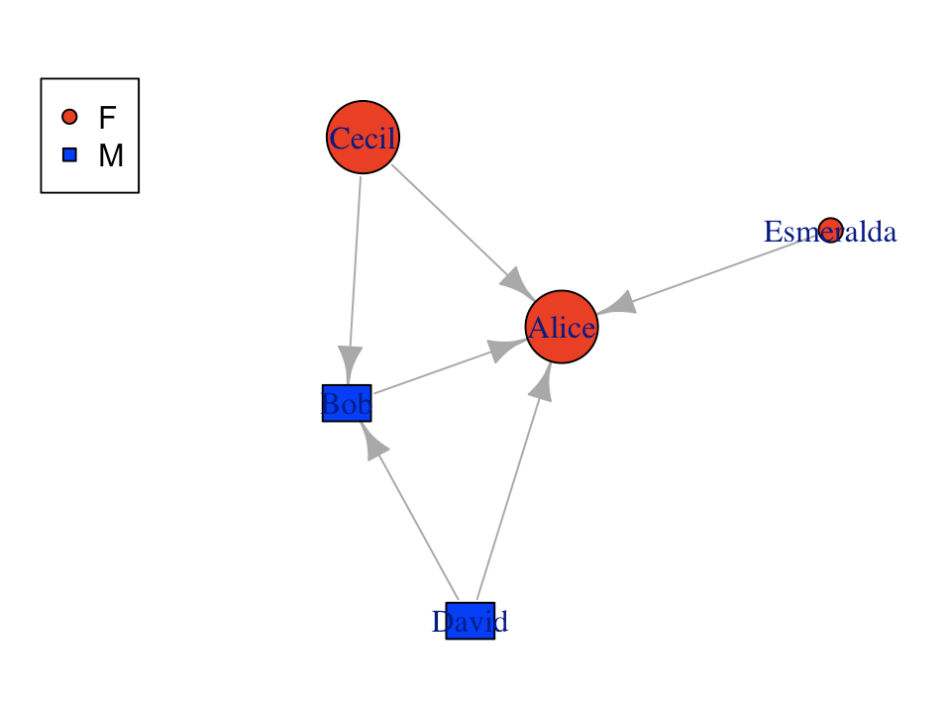
Vertice aesthetics – default igraph.plot
# make female and male color different
v = as_data_frame(g, what="vertice") %>% tbl_df %>%
mutate(color=case_when(gender=="F" ~ "red", gender=="M" ~ "blue"))
g = g %>% set_vertex_attr("color", value=v$color)
# make age as size
v = v %>% mutate(size=case_when(age < 30 ~ 10, age < 40 & age >30 ~ 20, age > 40 ~ 30))
g = g %>% set_vertex_attr("size", value=v$size)
# make gender as shape and put into vertex.shape para. In plot
v = v %>%
mutate(shape=case_when(gender=="F" ~ "circle", gender=="M" ~ "rectangle"))
# plot
plot(g, vertex.shape=v$shape) legend('topleft',legend=unique(v$gender),pch=c(21, 22),pt.bg=c("red","blue"))

Slide 29
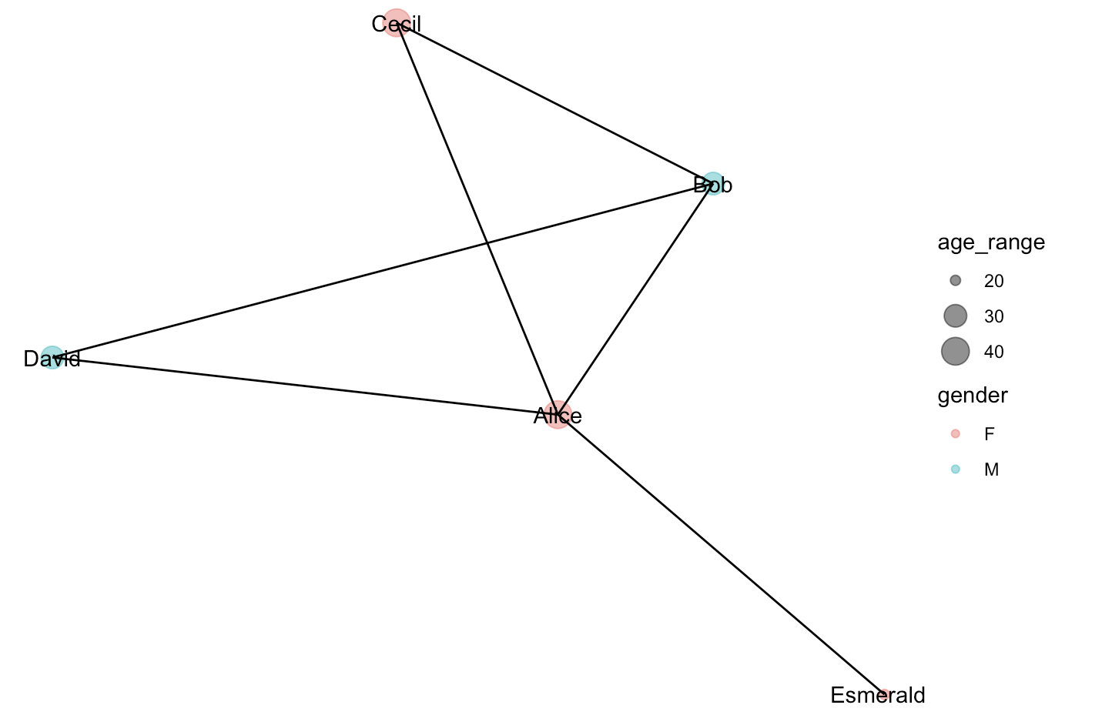
Vertice aesthetics – ggraph
# add age_range attr
v = v %>%
mutate(age_range=case_when(age < 30 ~ 20, age < 40 & age >30 ~ 30, age > 40 ~ 40))
g = g %>% set_vertex_attr("age_range", value=v$age_range)
# plot in ggraph
ggraph(g, layout = "kk") +
geom_node_point(aes(size=age_range, color=gender), alpha=0.5) + geom_node_text(aes(label=name)) + geom_edge_link() + scale_size_continuous(breaks=c(20,30,40), range = c(2, 6)) + theme_void()

Slide 30
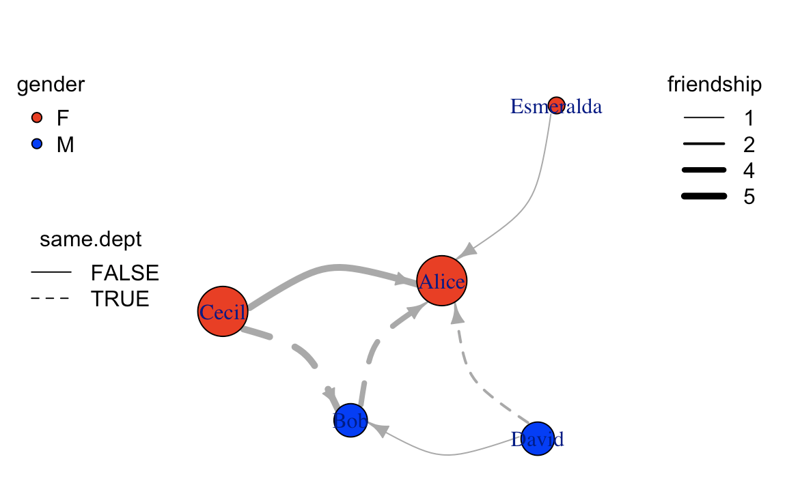
Edge aesthetics -- default igraph.plot
# use linetype present whether come from same department, and line width presents friendship
e = as_data_frame(g, what="edges") %>% tbl_df %>%
mutate(width=friendship) %>% mutate(lty=ifelse(same.dept,1,2))
# plot
plot(
g %>% set_edge_attr("width",value=e$width) %>% set_edge_attr("lty",value=e$lty),
edge.arrow.size=0.8, edge.curved=T
)
# legend
legend("topleft", legend=unique(v$gender),pch=21,pt.bg=c("red","blue"), title="gender", box.lty=0) legend("left",legend=unique(e$same.dept),lty=c(1,2), title = "same.dept",box.lty=0) legend("topright", legend=sort(unique(e$friendship)), lwd=sort(unique(e$friendship)), title="friendship", box.lty=0)

Slide 31
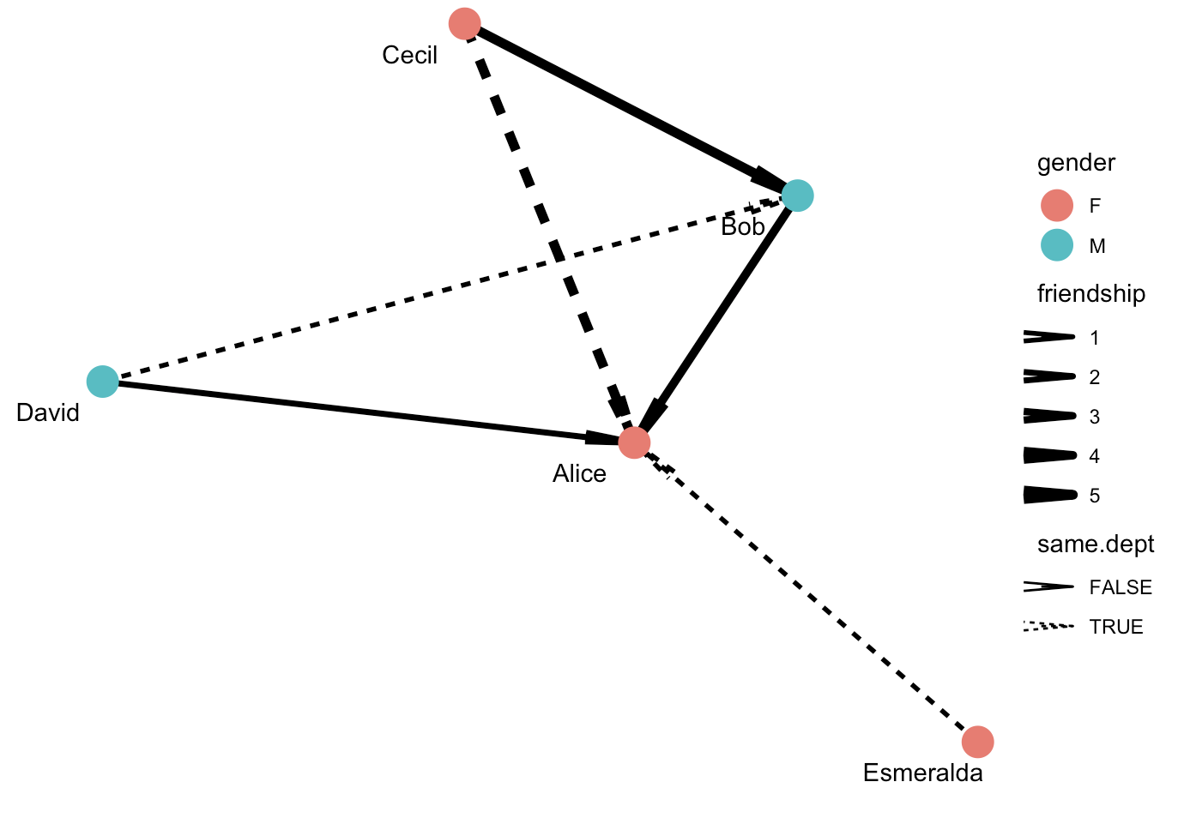
Edge aesthetics -- ggraph
ggraph(g, layout="kk") +
geom_edge_link(
aes(edge_width=friendship,
edge_linetype=same.dept),
arrow = arrow(angle=5, length = unit(0.3, "inches"))
) +
geom_node_point(aes(color=gender), size=6) +
geom_node_text(aes(label=name), nudge_y = -0.1, nudge_x = -0.1) + scale_edge_width(range = c(1, 2)) +
theme_void()

Slide 32
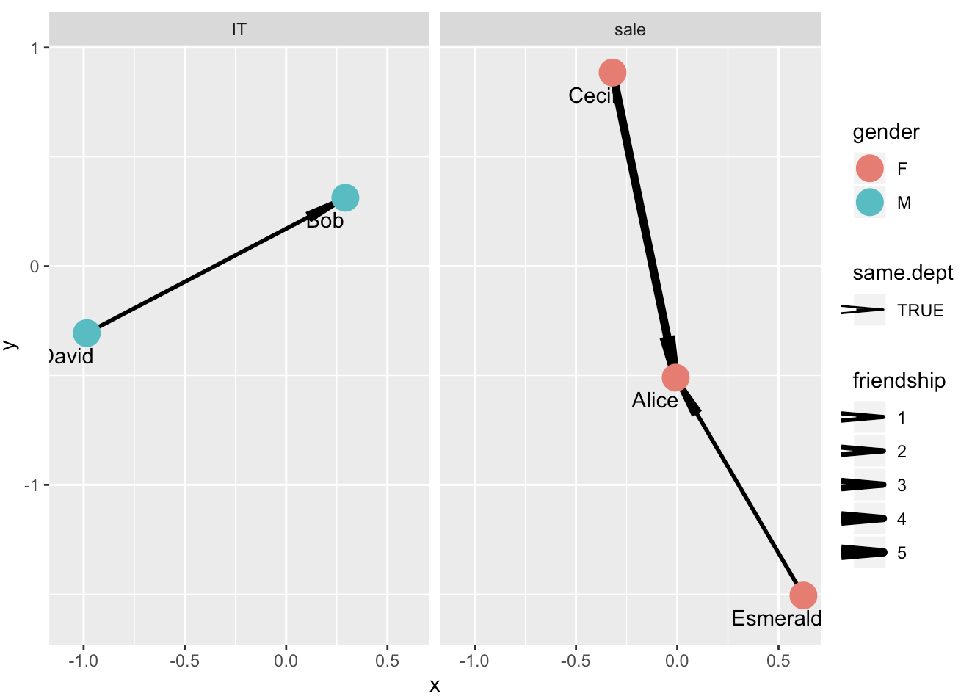
Facet
Facet in ggraph can be facet_edges, facet_nodes or facet_graph.
The first two are similar to facet_wrap while facet_graphs is comparable to facet_grid in ggplot
# add dept to graph
g = g %>% set_vertex_attr("dept",value=c("sale","IT","sale","IT","sale")) %>% set_edge_attr("same.dept",value=c(F,F,T,F,T,T))
# facet based on the dept
ggraph(g, layout="kk") +
facet_nodes(~dept, drop = F) + geom_edge_link(aes(edge_width=friendship, linetype=same.dept), arrow = arrow(angle=5, length = unit(0.3, "inches"))) + geom_node_point(aes(color=gender), size=6) +
geom_node_text(aes(label=name), nudge_y = -0.1, nudge_x = -0.1) +
scale_edge_width(range = c(1, 2))

Slide 33
Network layout
Network visualization layout depends on the coordinates of node at canvas. There are many internal-programed layout in both igraph and ggraph
Standard layouts
star: place one node in the center and the rest equidistantly around it. as_star()
circle: place nodes in a circle in the order of their index. in_circle()
nicely: default, tries to pick an appropriate layout. nicely
sphere: place nodes uniformly on a sphere - less relevant for 2D visualizations of networks. with_sphere()
fr: places nodes according to the force-directed algorithm of Fruchterman and Reingold. with_fr()
kk: uses the spring-based algorithm by Kamada and Kawai to place nodes. with_kk()
…… https://igraph.org/r/doc/layout_.html ….
Hierarchical layouts
tree: parent with the parent centered above its children. as_tree()
sugiyama: user-defined layers
Notes:
It helps viewers to see the network structure.

Slide 34
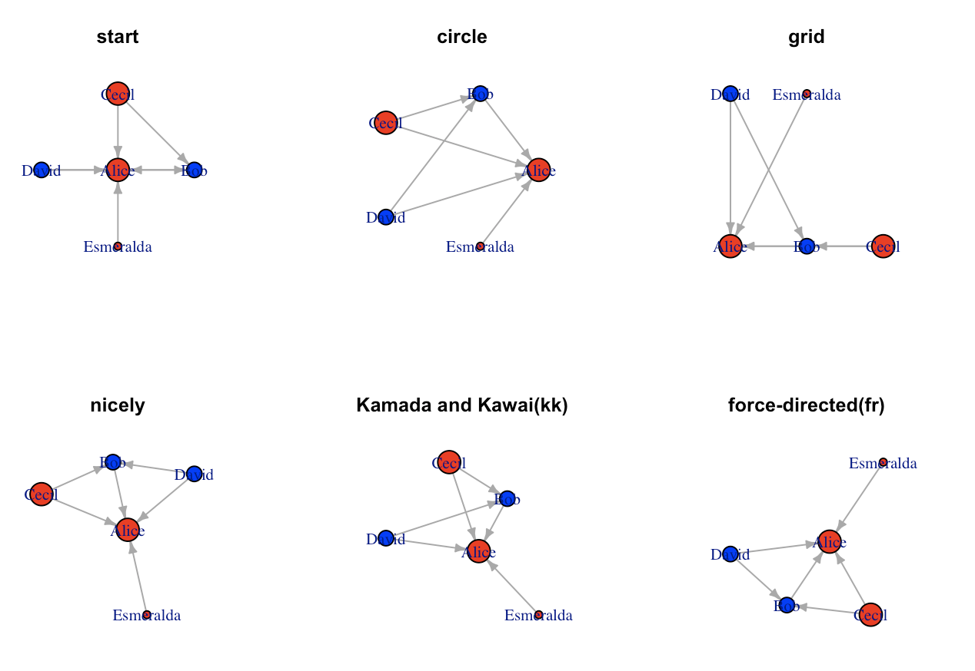

Slide 35
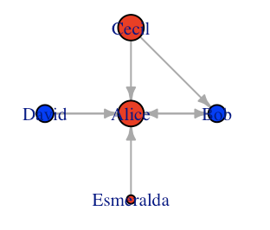
Specify layout in plot
# star layout in igraph default plot
coords <- layout_(g, as_star())
plot(g, layout = coords, edge.arrow.size=0.4)
title("star")
# star layout in ggraph
ggraph(g, layout=”star") + geom_edge_link(aes(edge_width=friendship, edge_linetype=same.dept), arrow = arrow(angle=5, length = unit(0.3, "inches"))) +
geom_node_point(aes(color=gender), size=6) + geom_node_text(aes(label=name), nudge_y = -0.1, nudge_x = -0.1) +
scale_edge_width(range = c(1, 2)) +
theme_void()

Slide 36
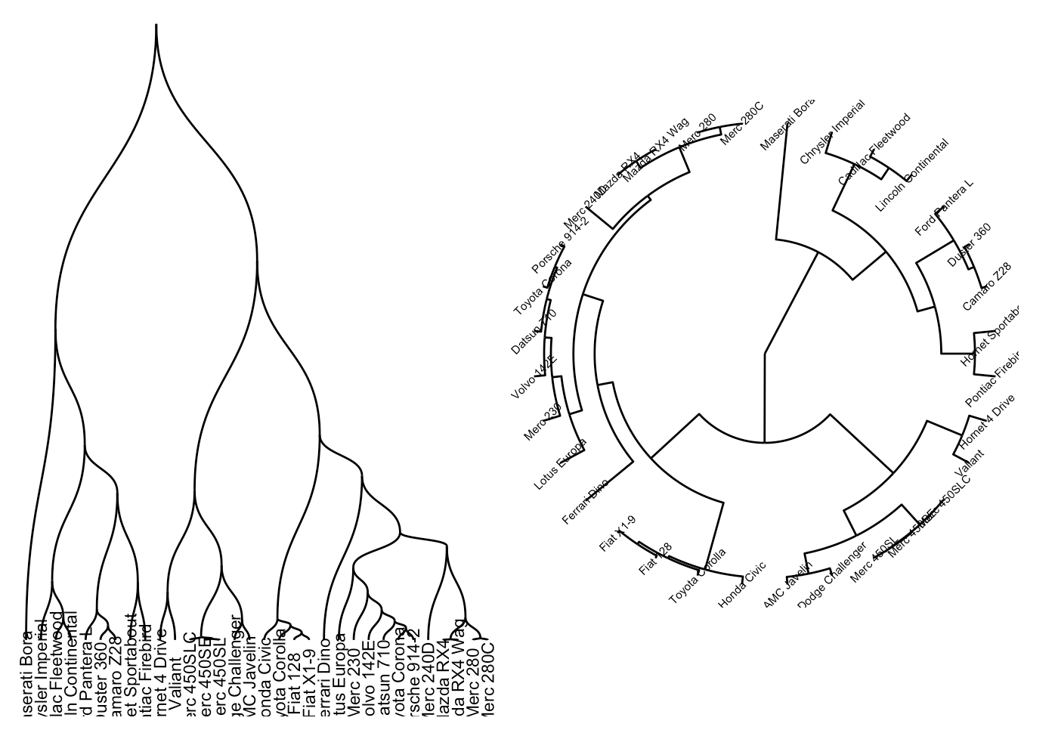
Extra layout in ggraph
Dendrogram: dendrogram layout not only take in graph object but also dendrogram object.
den <- as.dendrogram(hclust(dist(mtcars)))
p1 = ggraph(den, 'dendrogram') +
geom_edge_diagonal() +
geom_node_text(aes(label=label), angle=90, nudge_y=-30, size=3) +
theme_void()
p2 = ggraph(den, 'dendrogram', circular = TRUE) + geom_edge_elbow() +
geom_node_text(aes(label=label), angle=45, size=2) + coord_fixed()+
theme_void()
grid.arrange(p1,p2,ncol=2)

Slide 37
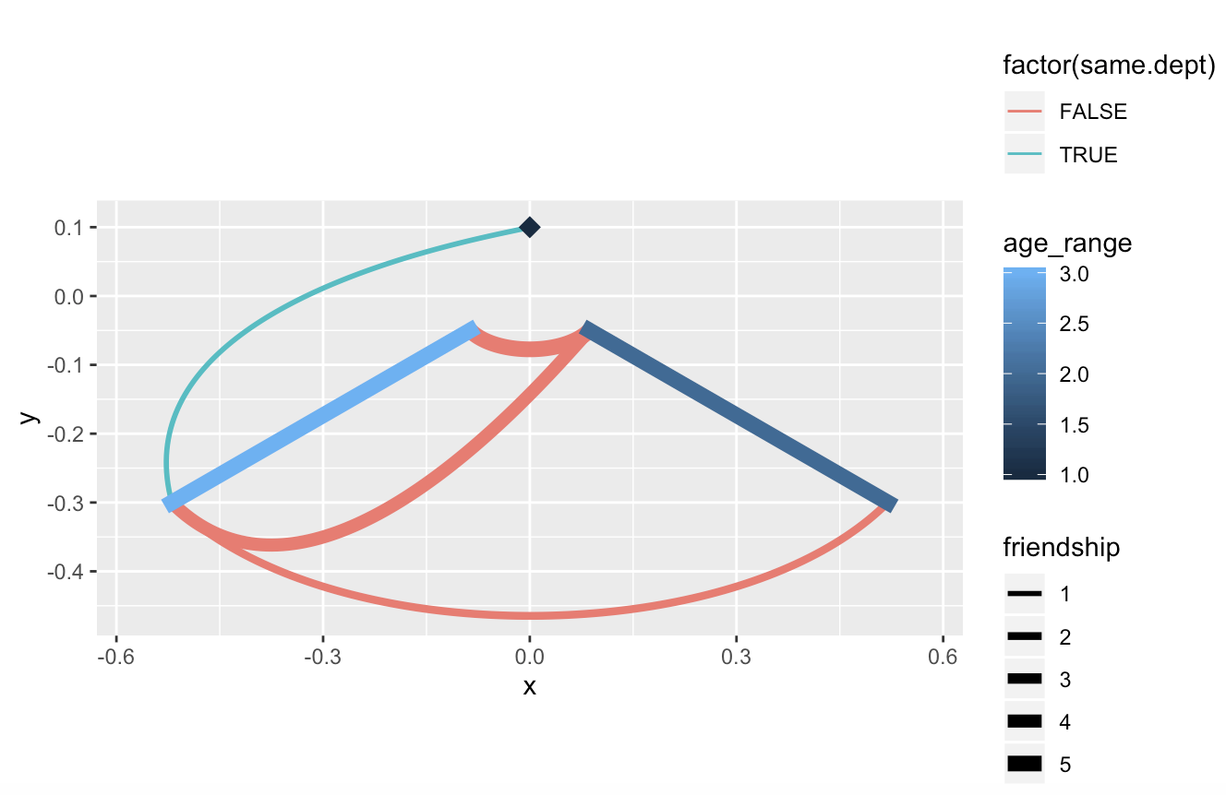
Extra layout in ggraph
Hive: make nodes group into a axis and connecting axis instead.
# group age_range into axis
V(g)$age_range = factor(V(g)$age_range)
ggraph(g, 'hive', axis = 'age_range', sort.by = 'age’) +
geom_edge_hive(aes(color = factor(same.dept), edge_width=friendship)) +
geom_axis_hive(aes(color = age_range), size = 3, label = FALSE) +
coord_fixed() +
scale_edge_width(range=c(1,3))

Slide 38
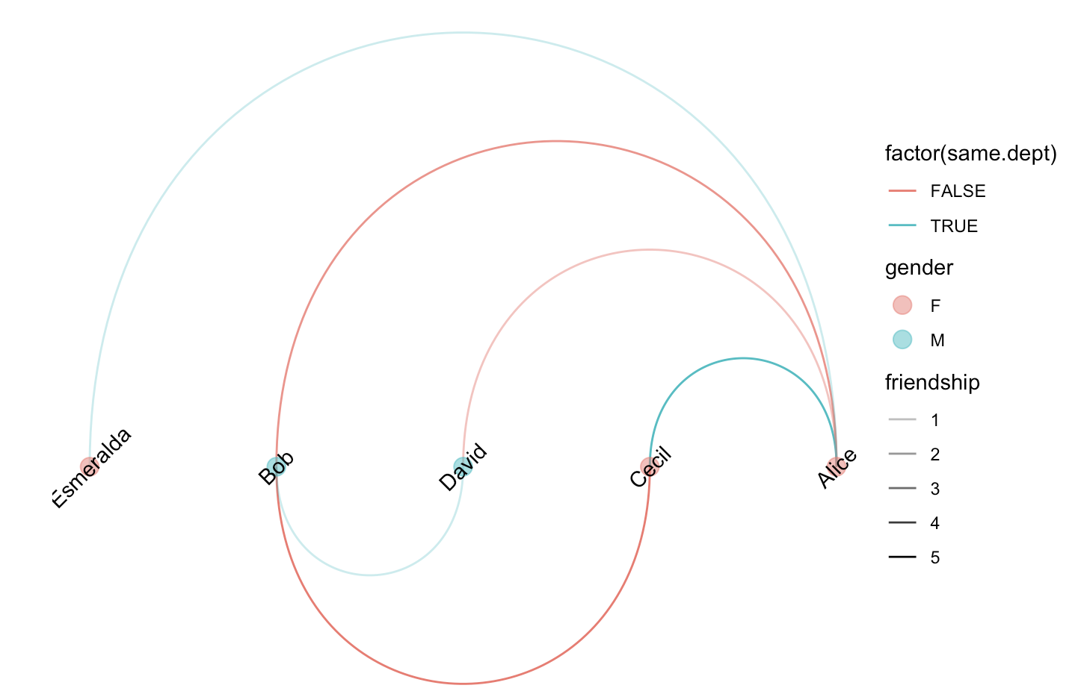
Extra layout in ggraph
Linear: all nodes at same line
ggraph(g, layout = 'linear', sort.by = 'age') +
geom_edge_arc(aes(color = factor(same.dept), edge_alpha=friendship)) +
geom_node_point(aes(color=gender), size=4, alpha=0.5) + geom_node_text(aes(label=name), angle=45) +
theme_void() + scale_edge_alpha(range=c(0.3,1))

Slide 39
Agenda
Network analysis basics
R object IGRAPH ”I/O”
object IGRAPH manipulation
Graph advance
Graph measurement
Graph cluster
Network visualization
Aesthetics of network elements
Network layout
Network application show case in Biology
Group Exercise – NYC flight

Slide 40
Network application in gene regulation
Topologically Associating Domains (TADs)
Nature Reviews Genetics volume 19, 453–467 (2018)

Slide 41
Cell-specific gene regulation network within TADs

Slide 42
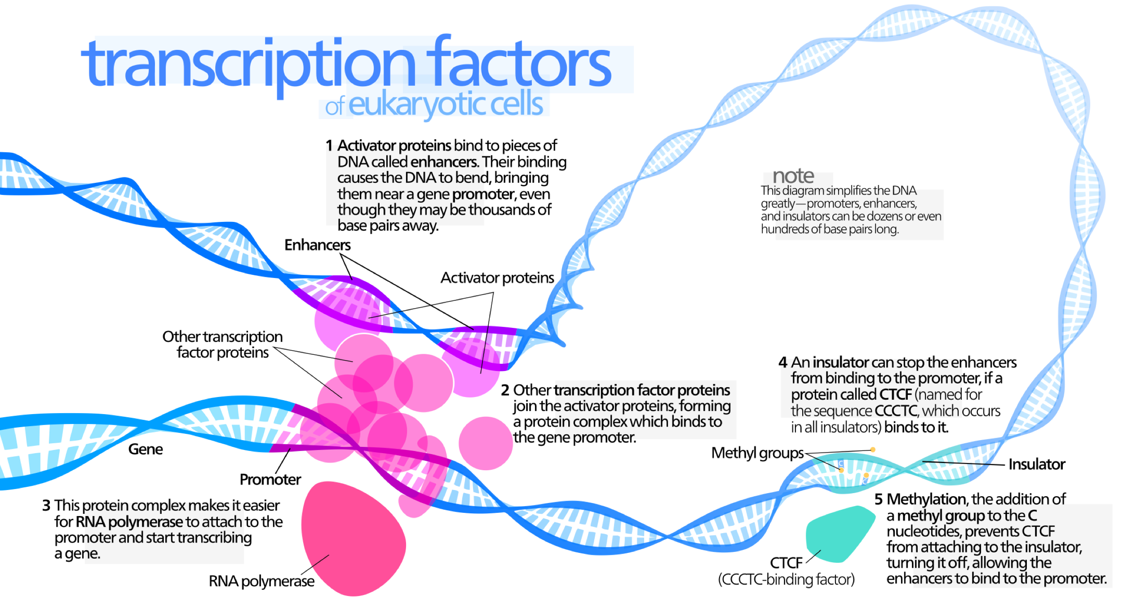
https://upload.wikimedia.org/wikipedia/commons/8/80/Transcription_Factors.svg

Slide 43
Gene regulation network with transcriptional factors
Layer 1: gene being regulated
Study- dependent
Study-independent
Layer 2: cis-element involved in gene regulation
Study-independent
Layer 3: TF directly binds to cis-element
Study-independent
Layer 4: Scaffold proteins that link TFs to bridge two cis elements

Slide 44
Other network packages
Network analysis tool:
Statnet: https://statnet.org/trac/wiki
Network visualization:
ggnet: https://briatte.github.io/ggnet/
Interactive network :
visNetwork: https://datastorm-open.github.io/visNetwork/
jstree: https://bwlewis.github.io/rthreejs/
Ndtv: http://statnet.csde.washington.edu/workshops/SUNBELT/current/ndtv/ndtv_workshop.html

